Slide 1

Machine Learning and Deep
Learning:
An Introduction
Somaiya Machine Learning Research Association (SMLRA)

Slide 2
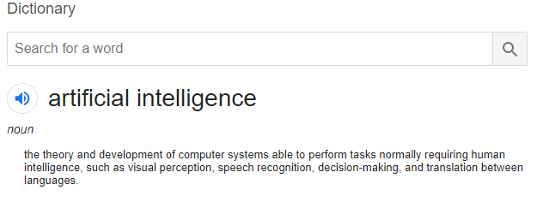
What’s Artificial Intelligence

Slide 3
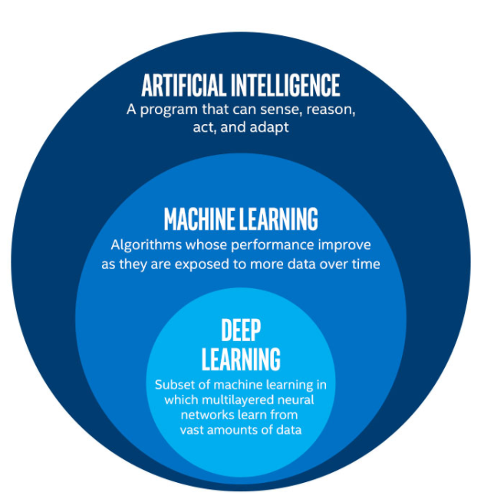
Where’s ML and DL??

Slide 4
Let’s Take a Programmer’s POV!
ML is when a system can change its parameters or use new data to improve its performance.
For Programmers:
System: Your Model
New Data: Information you tell the system
Performance: Whenever your model does what you want it to do!!!

Slide 5
Basic Types:Parametric and Non-Parametric
Parametric: When you have a FIXED set of parameters which you think clearly defines the data how much ever vast it is…
Non-Parametric: When you think the data can be defined by multiple parameters which may change or even increase as you put in more and more data. This can be as simple as saving each and every example!!

Slide 6
Supervised and Unsupervised
Supervised: You know what goes in and what should come out!
Unsupervised: You know what goes in, don’t know what should come out, but only have an idea of how good or bad it is.

Slide 7
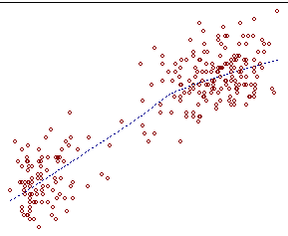

Slide 8
Googled ML? Would have seen RL!
Reinforcement Learning:You know what goes in, don’t know what comes out, but can measure how well it’s going.

Slide 9
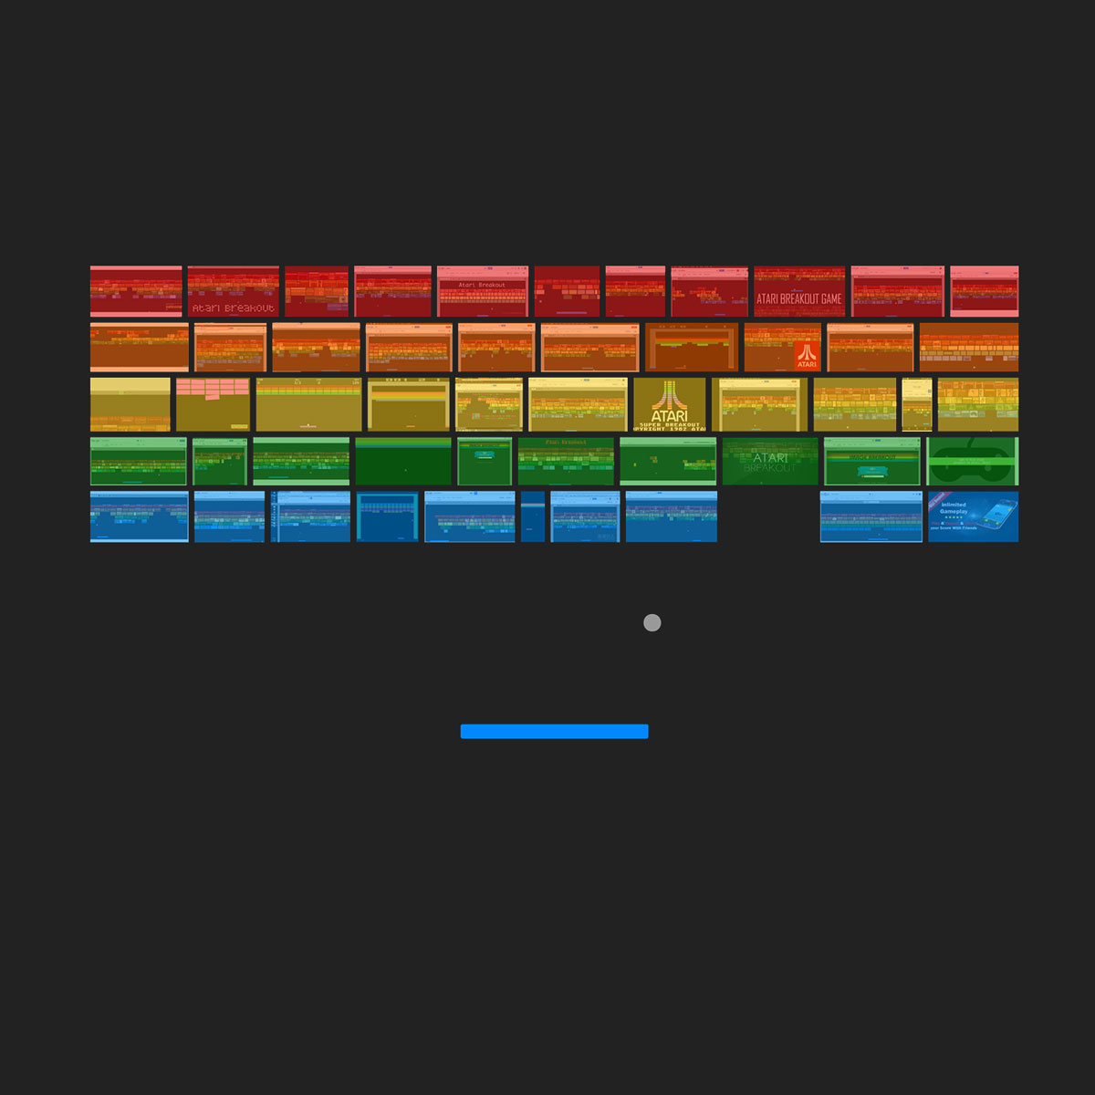

Slide 10
Recommender Systems
Collaborative: Suggest to a user based on other similar users.
Content Based: Suggest to a user based on a similar product.

Slide 11
Started Exploring much more? Semi-Supervised Learning!!
Semi-Supervised Learning: Sometimes you know what you want , sometimes you don’t. But still want to learn by both knowing the output and observing the patterns.

Slide 12
Went too deep? Knowledge Distillation!
Knowledge Distillation: You train one model, it trains another model and is suitable for what you want to do.

Slide 13
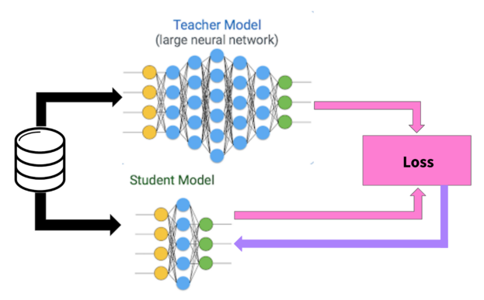
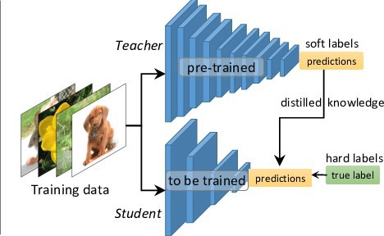

Slide 14
Active Learning
Active Learning: Model decides which examples it may need to learn better based on how bad it is performing on them.

Slide 15
What ML is NOT!!!
It is not just a science it is also an art.
It is not just if and else, it is also everything in between.
There is NO GREEN TICK!
It knows only what it sees, can’t help beyond that!!
It is not a human, not like a human, can fail even when you least expect it to, but may outperform you in a GIVEN task.
Better know what you built or better build something simpler!!!

Slide 16
PPTs.stop() ColabNotebooks.load()

